Slide 1


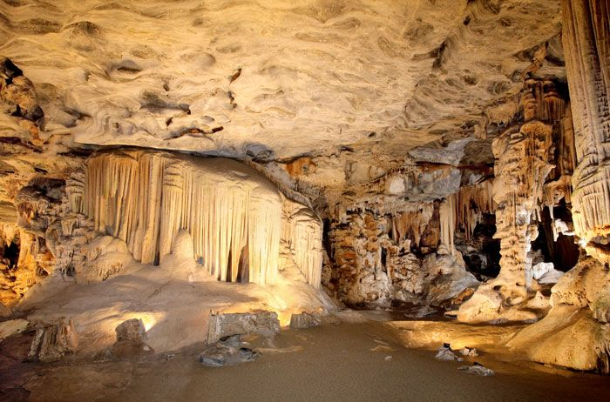
#KnowYourMunicipality: The 2024 Socio-Economic Profile
Oudtshoorn Municipality

Slide 2

  OUDTSHOORN: AT A GLANCE………………………………….………………… 3
  Introduction….………………………………………………………………………. 4
  Demographics…..…………………………………………………………………... 5
  Education……………………...………………………………................................ 7
  Health………...……………………………………………………………………….. 9
  Poverty….………………………………………………………………………..…… 11
  Basic Service Delivery ……………………………………………………………... 13
  Safety and Security ……………………………………….………………………... 15
  GDPR Performance…………………………………………………………………. 17
  Labour Market Performance …………………………………………………….. 19
  Risk and Vulnerability Factors…………………………………………………….. 21
  Conclusion………………………………………………………………………….... 23
SOURCES…………………………………………………………………………....... 24

Slide 3















Oudtshoorn Municipality: At a Glance
Demographics
Population, 2024; Actual households, 2024
Population
Households
93 138
20 669
Education
2023
Poverty
2023
Matric Pass Rate
80.7%
0.57
Learner Retention Rate
71.7%
Gini Coefficient
76.6%
29.2
Poverty Head Count Ratio (UBPL)
Learner-Teacher Ratio
Health
2023/24
Primary Health Care Facilities
Immunisation Rate
Maternal Mortality Ratio (per 100 000 live births)
Teenage Pregnancies – Delivery rate to women U/19
6
(excl. mobile/satellite clinics)
100.2%
0
20.3%
Safety and Security
Actual number of reported cases in 2023/24
Residential Burglaries
DUI
Drug-related Crimes
Murder
Sexual Offences
450
105
1 365
26
147
Access to Basic Service Delivery
Percentage of households with access to basic services, 2023
Water
Refuse Removal
Electricity
Sanitation
Formal Housing
99.5%
89.0%
91.7%
90.2%
91.3%
Road Safety
Labour
Socio-economic Risks
2021/22
2023
Fatal Crashes
10
Unemployment Rate
(narrow definition)
Risk 1
Risk 2
Risk 3
Road User Fatalities
12
32.4%
Unemployment
Poverty
Safety and security
Largest 3 Sectors
Contribution to GDP, 2023
Finance, insurance, real estate and business services
Manufacturing
Wholesale & retail trade, catering and accommodation
28.3%
17.6%
13.5%

Slide 4
INTRODUCTION
This publication is produced by the Provincial Treasury for each of the Western Cape municipalities on an annual basis. These socio-economic profiles provide each municipality with up to date
socio-economic data as well as analysis pertaining to the municipal area, to assist in planning, budgeting and the prioritisation of municipal services.
The profiles include information on recent trends in GDP and labour market performance, demographics, education and health outcomes. It further unpacks per capita income, inequality and poverty, access to housing and basic services as well as crime levels. A new addition to the profile is the inclusion of risk and vulnerability indicators related to climate change which is critical to development.
Valuable insight can be gained as to the developmental challenges faced by communities residing within a specific geographical area. While some developmental challenges are not within the municipality’s mandate to address, these profiles also provide spatial information for other spheres of Government in order to improve the quality of lives of people within each municipal area.
This profile uses data primarily sourced from Statistics South Africa, administrative data from sector departments, the Municipal Economic Review and Outlook (MERO), S&P Global Insight Regional Explorer and Quantec. The data sourced from sector departments are the most recent that is available.
The format of the profile allows for easy readability with the data being displayed in infographics, followed by the relevant trend analyses.
The information contained in this profile highlights information for the Oudtshoorn Municipality in relation to the broader Garden Route District.

Slide 5







DEMOGRAPHICS
Current Population 2024
Estimated Population Growth
93 138
Estimated Average Annual Population Growth Rate
2023 - 2029
Estimated Population
-0.6%
90 072 2029
Gender and Age Dynamics
Population by Age 2024
75+
70-74
65-69
60-64
55-59
50-54
45-49
40-44
35-39
30-34
25-29
20-24
15-19
10-14
5-9
0-4
Total
9.5%
Aged
(65+ Years)
Female
Male
63.0%
52.2%
47.8%
Working Age
(15-64 Years)
58.6
34.8
27.4%
Dependency Ratio
Children
(0-14 Years)
Ageing Index
Population and Household Growth 2024
Racial Split
4.3
Household Size
Population Density Oudtshoorn 2024
2024
Kannaland
Oudtshoorn
26.3
people/km²
4.6
26.3
George
46.3
200
26.1
people/km²
2025
Knysna
Bitou
Hessequa
Mossel Bay
73.9
79.5
26.0
people/km²
2026
9.6
51.8

Slide 6
DEMOGRAPHICS
Population and Household Growth
In 2024, the Oudtshoorn Municipality was home to 93 138 individuals, making it the third most populated municipal area within the region. The Mid-year population estimates (MYPE) released by Stats SA in September 2024 reflects that the municipal population is anticipated to decline at an annual average rate of 0.6 per cent over the 2024 to 2029 period. This demographic decline is potentially driven by semigration from this locale into more developed regions. The only suburbs within the municipal area that are estimated to have seen increases over the decade between 2011 and 2021 are Bongolethu and Bridgeton.
With a total of 20 669 households recorded in 2024, the Oudtshoorn municipal area exhibits an average household size of 4.3 persons. This is significantly greater than the district average of 3.3. With the high levels of poverty in the municipal area (highest in the district) the large household sizes may stem from the challenge faced by individuals to afford separate living arrangements. Multiple family members therefore share a single household. The average household size recorded a slight decline from
4.4 persons in 2011. This is reflective of outmigration by members of the household and declining fertility rates. Household growth is therefore forecast to stagnate over the 2024 to 2029 period, while the outmigration and declining fertility rates leads to a forecasted population decline. Furthermore, it is noteworthy that the number of households recorded during the 2022 Census exceeds the count employed in the Local Government Equitable Share calculations by 25.4 per cent, signifying a
higher-than-projected rise of households over the interval from 2011 to 2022. The divergence, also evident when comparing the MYPE and Census figures, bears implications for the provisioning of municipal services and the requisite infrastructure.
Gender, Age and Race Dynamics
A more in-depth analysis of the demographic composition within the municipal area reveals that
63.0 per cent of its residents fall within the economically active age group of 15 to 64 years. The overall population distribution leans in favour of females only from age group 25 to 29 and upward, reflecting an outmigration of working aged males from the municipal area after the age of 24, ostensibly in pursuit of employment opportunities elsewhere. Moreover, a segment comprising 27.4 per cent of the population is aged below 14 years, thereby engendering a comparatively high dependency on the working-age cohort. This sizable youth contingent underscores demand for educational resources and future employment prospects within the municipal area. Additionally, a relatively sizable elderly population, constituting 9.5 per cent of the total, signifies that the municipal area is an attractive destination for retirement, a pattern observed across the scenic expanse of the Garden Route. The insights derived from the age distribution patterns are instrumental for municipal planning, particularly concerning the availability of housing and government services tailored to meet the diverse needs of distinct age groups. Sustainable employment expansion holds paramount significance for the municipal area to mitigate the outmigration of the working-age populace, capable of actively fostering economic growth.
Furthermore, the prominent racial demographic category in the municipal area is the coloured population, representing 76.7 per cent of the total population, followed by the black African population at 12.1 per cent and the white population at 10.9 per cent. The Indian or Asian demographic group is the minority, accounting for merely 0.3 per cent of the municipal populace.
Level of Urbanisation and Population Density
The Oudtshoorn municipal area spans 3 537.1 km² and is situated in the semi-arid Klein Karoo. In 2024, it had a relatively low population density of 26.3 persons per km² and is expected to decrease to
26.0 persons per km² by 2026. The population is concentrated within the towns of Oudtshoorn, Bridgeton and Bongolethu, with Bridgeton and Bongolethu having the highest population densities, a key consideration in spatial planning and budgeting.

Slide 7





Education Infographic
EDUCATION
Learner enrolment
2020 - 2023
Educational facilities
2023
34
Number of schools
85,3 %
Proportion of no-fee schools
Number of schools with libraries
16
Learner retention
2020 - 2023
Learner-teacher ratio 2020 - 2023
2020 | 2021 | 2022 | 2023
Garden Route District
Hessequa
Oudtshoorn
George
Kannaland
Mossel Bay
30.1 | 30.9 | 29.8 | 29.1
30.9 | 31.7 | 31.2 | 31.4
29.1 | 28.9 | 28.7 | 27.7
30.2 | 30.9 | 30.1 | 29.4
30.0 | 29.7 | 29.7 | 28.9
29.6 | 29.7 | 29.7 | 29.2
Bitou
32.3 | 32.4 | 31.8 | 30.6
Knysna
30.1 | 30.3 | 29.0 | 27.9
Matric outcomes 2020 - 2023
Matric subject outcomes Oudtshoorn 2023
5 per cent
85 per cent

Slide 8
EDUCATION
Learner enrolment and learner-teacher ratio
Ensuring that school aged children have access to schools and are enrolled allows the community to meet its future skills demands, builds a foundation for a more informed and productive society and is instrumental in improving the overall quality of life. In 2023, the Oudtshoorn municipal area ranked second in the GRD in terms of enrolled learners, attributed to its comparatively sizable youth demographic. In line with an overall population decline, the municipal area demonstrated a marginal decline in learner enrollment by 148, and along with Kannaland, are the only two municipalities to experience a decrease in learner enrolment from 2022 to 2023. This nominal decrease in learner enrollments is indicative of diminishing fertility rates and outmigration patterns within the municipal area and contributed to a declining learner-teacher ratio, which at 29.2 in 2023, is however slightly above the GRD average.
Education infrastructure and facilities
Education and skills development play a vital role in shaping the future socioeconomic landscape of the municipal area. They empower the population and significantly impact the local economy’s development and its human resource capacity. The Western Cape Education Department (WCED) is committed to this cause, ensuring access to education for the children of the municipal area with the availability of 34 schools. Furthermore, the WCED recognizes the need for education facilities in this Municipality with its particularly large youth cohort (children under 14 years of age) and has as such allocated R50.0 million towards the construction of a new high school in De Rust in the 2023/24 MTEF. The municipal area is also somewhat of an education centre in the GRD because of the presence of the South African Army Infantry School and a Technical and Vocational Education and Training (TVET) campus. This contributed to a 3.1 percentage point rise in the proportion of individuals over the age of 20 with higher education qualifications across the 2011 to 2022 period.
Of the 34 schools in the municipal area, 85.3 per cent operate as no fee schools. This is positive to note given that a substantial 24 per cent of learners in 2021 cited financial constraints as the primary reason for prematurely dropping out of school. In addition, 16 schools have libraries. This is particularly crucial to the disadvantaged learners of the municipal area, creating an enriched learning environment that supports academic achievement, fosters a love for reading, and prepares students for a lifetime of learning.
Learner Retention
The municipal area exhibits a learner retention rate that is in line with the District average. It has also demonstrated a consistent upward trajectory from 2020 (69.1 per cent) to 2022 (73.8 per cent), but declined to 71.7 per cent. This trend needs to be reverted to enhance the future economic potential of the municipal area.
Education Outcomes
The municipal area is experiencing both a reduction in the proportion of learners completing Grade 12 and a decline in matric pass rates, from 83.9 per cent in 2022 to 80.7 per cent in 2023, now falling below the District average of 85.8 per cent. Of particular concern is the decrease in bachelor-level passes, with subject-specific analyses indicating that poor outcomes in Mathematical Literacy and Afrikaans Home Language are contributing factors. Furthermore, the limited uptake of Mathematics among learners restricts their access to critical fields, especially those in increasing demand across the national economy.
Addressing these challenges is crucial, especially given the importance of proficiency in subjects like Mathematics and Physical Science in the context of the evolving Fourth Industrial Revolution. As demand for skilled labor rises within the municipal area, matric certificates and higher education qualifications are becoming increasingly vital tools for alleviating poverty and driving economic growth. It is essential to thoroughly examine the factors affecting educational quality to improve long-term outcomes.

Slide 9







Education Infographic
HEALTH
Healthcare Facilities
Emergency Medical Services
6 Fixed PHC Facilities
3 Mobile Clinics
11 ART Clinics/ Treatment Sites
9 TB Clinics/ Treatment Sites
1 District Hospital
EMS per 10 000 people
GRD | 0.4
Kannaland | 1.8
Hessequa | 0.7
Mossel Bay | 0.3
George | 0.4
Oudtshoorn | 0.5
Bitou | 0.1
Knysna | 0.2
Number of ambulances:
6
Number of ambulances 2023:
5
Maternal Health
Child Health
OUDTSHOORN 2024:
Maternal Health Indicators
Maternal deaths in facility : 0
Deliveries in facility u19 years : 343
Termination of pregnancy : 37
OUDTSHOORN 2024:
Child Health Indicators
Live births under 2500g (low birth weight) : 334
Immunisation u1 year : 1 535
Severe acute malnutrition u5 years : 36
Inpatient deaths 6-28 day : 18
HIV/AIDS
Tuberculosis

Slide 10
HEALTH
Healthcare services
In 2023, a mere 15.7 per cent of the South African population had access to medical aid, underscoring the significance of government healthcare facilities in delivering essential primary healthcare services to the majority of the country's residents. Within the Oudtshoorn municipal area during the same year, there were a total of 6 primary healthcare facilities. Additionally, the municipal area had
3 mobile/satellite clinics and one district hospital, catering to the healthcare needs of the residents. It is noteworthy that this municipal area accounted for 14.9 per cent of the healthcare facilities present in the broader Garden Route District.
In 2023, residents in the municipal area had access to 11 Antiretroviral Treatment (ART) sites and
11 tuberculosis (TB) clinics, following the closure of two TB treatment sites since 2022. The reduction in TB clinics aligns with the declining number of registered TB patients. However, the ART patient load continues to rise, despite a decrease in the number of new ART registrations compared to the previous year.
Enhancing the quantity of functional ambulances contributes to an expanded reach of emergency medical services across the municipal area. During the fiscal year 2023/24, the municipal area was equipped with 5 Provincial ambulances, equating to a ratio of 0.5 ambulances per 10 000 residents. This is above the GRD average of 0.4 ambulances per 10 000 residents. It is imperative to acknowledge that this metric exclusively accounts for Provincial ambulances and does not encompass services provided by private entities.
Child and maternal health
Within the municipal area, there has been a marginal decrease in teenage pregnancies. In 2023/24,
343 deliveries (20.3 per cent) occurred among females under the age of 20, which is significantly greater than the District rate of 11.5 per cent. The slight decrease in teenagers giving birth coincided with a slight decline in pregnancy terminations, with 37 pregnancy terminations reported in 2023/24. The high rate of teenage pregnancies reflects a need for expanded family planning initiatives and support services within the municipal area and greater GRD, as unplanned pregnancies pose a risk to the future quality of life of teenagers.
1 535 children under the age of one were immunised, translating to an immunisation coverage rate of 100.2 per cent. It also exhibited an increase from the previous year thereby reducing the proportion of young children at risk of serious illness. The prevalence of malnourished children under the age of five, particularly those suffering from severe acute malnutrition, per 100 000 individuals in the municipal area, decreased from 2022/23 to 2023/24. Unfortunately, there is an observed increase in the percentage of infants born with a birth weight below 2.5 kilograms during this period. The latter metric has yet to revert to pre-pandemic levels. Notably, these indicators surpass the district average, underscoring a distinct challenge concerning food security and malnutrition within the municipal area. The high levels of poverty in the municipal area contribute significantly to an enduring challenge regarding households' access to nutritious food.
The municipal area recorded no maternal fatalities; however, regrettably, 8 infants succumbed before reaching 28 days of life. While the municipal area previously exhibited one of the highest neonatal mortality rates within the GRD, there has been a marked decline in 2023/24 denoting improved antenatal and postnatal care.

Slide 11



POVERTY
GDP per capita
Income Inequality
Poverty Line

Slide 12
POVERTY
GDPR Per Capita
Oudtshoorn’s GDP per capita shows moderate growth from 2020 to 2023, increasing from approximately R39 696 in 2020 to R41 391 in 2023. While this represents a steady improvement, Oudtshoorn remains below the GDP per capita of R42 536 recorded in 2017, indicating that
well-being has declined when compared to the pre-pandemic period. The growth trajectory highlights moderate economic performance relative to other municipalities such as George, which leads the district in GDP per capita.
It is imperative to acknowledge that the distribution of GDP per capita within the municipal area is not uniform. Disparities prevail, with a segment of the population enjoying affluence, while others grapple with financial challenges in an economic landscape characterized by inflation, high interest rates, and unemployment.
Income Inequality
South Africa suffers among the highest levels of inequality in the world when measured by the commonly used Gini index. Inequality manifests itself through a skewed income distribution, unequal access to opportunities, and regional disparities. The National Development Plan (NDP) has set a target of reducing income inequality in South Africa, endeavouring to lower the Gini coefficient from 0.7 in 2010 to 0.6 by 2030. As at 2023, the Oudtshoorn municipal area meets that goal at 0.57 and has amongst the most equally distributed incomes in the Province. When viewed in conjunction with the low GDP per capita, it reflects that the majority of the population are grappling with limited economic opportunities and resources. By global standards, the Gini coefficient of 0.57 is still high and reflects the discrepancy between persons with well renumerated jobs in the town of Oudtshoorn, compared to the lower income earned by farm workers as well as backyard dwellers and households residing in the informal settlements across the municipal area. Income inequality is also more pronounced among the coloured and black African demographic groups where some households have built wealth, whilst others have yet to escape the poverty trap.
Poverty
The Upper Bound Poverty Line (UBPL) head count ratio is the proportion of the population living below the UBPL i.e., that cannot afford to purchase adequate levels of food and non-food items. The UBPL in South Africa is R1 558 (in April 2023 prices) per person per month. In 2023, 76.6 per cent of the municipal population fell below the UBPL. This figure improved marginally from the 74.8 per cent recorded in 2017, indicating some progress despite the challenging economic conditions facing households across the country.
The municipal area exhibits the highest levels of poverty in the District. This points to a significant number of households being confronted with the adverse effects of poverty. These consequences include lower life expectancy, malnutrition, food insecurity, heightened exposure to crime and substance abuse, reduced educational attainment, and substandard living conditions. Therefore, the NDP sets the ambitious goal of eradicating poverty by 2030.
Relative to the GRD, Oudtshoorn exhibits below-average economic performance, with a lower GDP per capita and a higher poverty rate. While its income inequality aligns with district-wide patterns, its slower reduction in poverty suggests a need for intensified efforts to address economic vulnerabilities. Enhanced investment in infrastructure, skills development, and employment opportunities could support more inclusive growth and reduce poverty in the municipality.

Slide 13









BASIC SERVICE DELIVERY
2023
20 669
190 263
Oudtshoorn
Garden Route District
Total number of households
Formal main dwelling
91.3%
89.4%
Oudtshoorn
Garden Route District
91.3% Oudtshoorn
89.4% Garden Route
1.7% Oudtshoorn
1.3% Garden Route
8.4% Oudtshoorn
10.4% Garden Route
0.3% Oudtshoorn
0.2% Garden Route
Formal Dwelling
Traditional dwelling
Informal Dwelling
Other/Unspecified
Piped water inside dwelling/yard or communal/neighbor’s tap
Flush/chemical toilet
Oudtshoorn
99.5%
Oudtshoorn
90.2%
Garden Route
99.4%
Garden Route
94.5%
Electricity (incl. generator) as primary source of lighting
Refuse removal at least once a week
Oudtshoorn
91.7%
Oudtshoorn
89.0%
Garden Route
95.8%
Garden Route
90.9%
Indigent Households Garden Route Municipalities

Slide 14
Basic Service Delivery
Introduction
The Constitution stipulates that every citizen has the right to access to adequate housing and that the state must take reasonable legislative and other measures within its available resources to achieve the progressive realisation of this right. Access to housing also includes access to services such as potable water, basic sanitation, safe energy sources and refuse removal services, to ensure that households enjoy a decent standard of living.
This section assesses the extent to which this objective has been realised by examining the progress reflected in the 2023 Quantec Data.
Housing and Household Services
Of the 20 669 households within the Oudtshoorn municipal area, 91.3 per cent had access to formal housing, slightly above the Garden Route District average of 89.4 per cent. This achievement is largely attributed to housing units constructed by the state, catering to the housing needs of low-income households, while the growth in households are subdued. Furthermore, the GRD average which has been dragged downward due to the large proportion of informal housing in the George municipal area. With 8.4 per cent of households living in informal dwellings, 1.7 per cent in traditional dwellings and 0.3 per cent in other/unspecified housing, it reflects further room for improvement to see enhanced living conditions for vulnerable households in the Oudtshoorn municipal area.
Access levels for essential services in the municipal area—excluding flush/chemical toilet and refuse removal—surpassed the access to formal housing. Specifically, 99.5 per cent of households had access to piped water (within the dwelling, yard, or via a communal/neighbor’s tap), 90.2 per cent had access to a flush or chemical toilet, 91.7 per cent had access to electricity (including generators) for lighting, and 89.0 per cent received weekly refuse removal by the local authority. However, these service access levels were below the corresponding District averages across all categories, excluding only piped water. This lag underscores the Municipality’s difficulties associated with extending services to rural farmlands and informal settlements, as well as a potential lack of access to these basic services within backyard dwellings.
Free Basic Services
Municipalities also provide a package of free basic services to households who are financially vulnerable and struggle to pay for services. The COVID-19 pandemic induced a notable 16.7 per cent rise in registered indigent households in 2020, driven by income losses that impaired households' ability to afford municipal services. Although the rate of growth moderated, the upward trend persisted with a 4.6 per cent increase in 2021, followed by a 0.6 per cent rise in 2022, indicating a continued deviation from pre-pandemic levels. A positive shift emerged in 2023, marked by a substantial 5.5 per cent reduction in indigent households to 7 193. While economic conditions have shown improvement, household incomes remain under pressure, sustaining high demand for free basic services.

Slide 15

SAFETY AND SECURITY
Garden Route
OUDTSHOORN
2 903 Total reported crime per 100 000 people in the Garden Route District in 2023/24
2 659 Total reported crime per 100 000 people in Oudtshoorn in 2023/24
Drug-related crime
Burglary at residential premises
Common assault
Malicious damage to property
Commercial crime
Driving under the influence
Sexual offences
Murder
Drug-related crime
772 (2022/23)
1 365 (2023/24)
Residential burglaries
471 (2022/23)
450 (2023/24)
Murder
22 (2022/23)
26 (2023/24)
Common assault
734 (2022/23)
825 (2023/24)
Actual numbers of reported crime
Sexual offences
142 (2022/23)
147 (2023/24)
Damage to property
442 (2022/23)
470 (2023/24)
Driving under the influence
46 (2022/23)
105 (2023/24)
Commercial crime
194 (2022/23)
290 (2023/24)

Slide 16
SAFETY AND SECURITY
Crime Rates in GRD and Oudtshoorn Municipality
The high levels of poverty and inequality give rise to elevated crime levels necessitating the development of the Western Cape Safety Plan. In it, the Western Cape Government (WCG) expresses their vision to ensure that the Province is a place where all people feel secure and live free from fear. The Oudtshoorn Municipality shares in this goal, as it is not spared from the safety concerns present throughout the Province and GRD.
Crime rates in the municipal area declined from 2022/23 to 2023/24. It is also lower than the overall GRD crime rate. The Oudtshoorn Municipality’s is working towards maintaining its position as a safe town, as outlined in its Integrated Development Plan (IDP). In fact, at an aggregate level, the incidence of crime per 100 000 residents in the Oudtshoorn municipal area ranks as the lowest in the region at 2 659.
Drug-related offenses is the most common serious crime committed within the municipal area. The Municipality further exhibits reduced occurrences of contact crimes, such as common assault and sexual offences and murder, and are lower when compared to the GRD.
The primary factors contributing to crime in the Oudtshoorn Municipality and greater region of the Garden Route include the absence of surveillance cameras in high-risk areas, inadequate lighting, high unemployment rates, drug and alcohol abuse, instances of domestic violence, repeat offences by released prisoners, the seasonal influx of labourers and social intolerance. Furthermore, crime is exacerbated by the high levels of poverty in the municipal area.
Total Reported Cases of Crimes
Murder is defined as the unlawful and intentional killing of another person. 26 murders were reported in the municipal area in 2023/24, which increased from 22 in the previous year. Similarly, common assault (assault that involves the use of force or violence against another person without causing serious bodily harm) is at heightened levels with 825 cases reported, influenced by substance abuse, gangsterism as well as gender-based violence.
South Africa is amongst the top 5 countries in the world with respect to reports of rape. Oudtshoorn is no exception with 147 cases of sexual offences (including rape, sex work, pornography, public indecency and human trafficking) reported within the municipal area, up from 142 in 2022/23. It should be noted that many cases of sexual offences go unreported. Substance abuse drives up drug-related crimes (a situation where the perpetrator is found to be in possession of, under the influence of, or selling illegal drugs) with 1 365 cases reported, and saw the largest rise from the total incidences recorded in 2022/23. In addition, driving under the influence of drugs or alcohol (where the driver of a vehicle is found to be over the legal blood alcohol limit) had 105 reported cases in 2023/24. Alcohol use is a leading factor in road traffic crashes. Substance abuse places a burden on health care and police services, disrupts families and bears significant social and economic costs within communities.
Substance abuse and poverty further contribute to residential burglaries (the unlawful entry of a residential structure with the intent to commit a crime, usually a theft) with 450 cases reported in the municipal area, while difficult economic times is met with a rise in commercial crimes (theft, fraud or dishonesty committed against a business by an employee that results in the business suffering financial loss) as an easy way for employees to maintain their standard of living. In addition to this, 470 cases of malicious damage to property, severely impact local businesses, especially SMMEs. Failure to curb such crimes can lead to a vicious cycle of declining economic activity and joblessness that fuels poverty and gives rise to other crimes across the Municipality. Curbing crime is thus crucial to realising the vision of the WCG that is “a safer Western Cape where everyone prospers”.

Slide 17













GDPR PERFORMANCE
GDPR Contribution 2023
Sectoral contribution to GDPR 2023
Oudtshoorn
R5.797 bn
12.6 per cent
Kannaland
R1.298 bn
2.8 per cent
George
R18.660 bn
40.4 per cent
Knysna
R4.924 bn
10.7 per cent
Bitou
R3.374 bn
7.3 per cent
Hessequa
R4.040 bn
8.8 per cent
Mossel Bay
R8.077 bn
17.5 per cent
Garden Route District
R46.170 bn
7.6 per cent of Western Cape GDPR
GDPR & Employment Growth 2022/23
GDPR forecast
International Trade, 2023
Tourism spend per cent of GDP
Imports
R53.6 million
Exports
R1.1 billion
Top exported products
Top imported products
Skins and other parts of birds, with their feathers or down
Skins and other parts of birds with their feathers or down, feathers, parts of feathers
Seeds, fruit and spores, of a kind used for sowing
Mechanical appliances
Sunflower seeds, whether or not broken
Seeds, fruit and spores, of a kind used for sowing

Slide 18
GDPR PERFORMANCE
GDPR Sectoral Performance
The Oudtshoorn municipal area, located in the semi-arid Klein Karoo, is home to three main towns: Oudtshoorn, famously known as the ostrich capital of the world; Dysselsdorp, a historic village founded as a British mission station; and De Rust, a charming town situated just north of the Olifants River. The region’s thriving ostrich farms are central to the local economy, not only offering unique tourism experiences but also supplying meat, feathers, and leather products, which fuel a vibrant trade in artisanal goods and support the local meat-processing industry.
Oudtshoorn contributes R5.797 billion (12.6 per cent) to the District’s GDP, highlighting its role as a mid-sized economic hub within the region. The district’s total GDP of R46.170 billion represents 7.6 per cent of the Western Cape’s economic output. Oudtshoorn’s economy aligns with district-wide trends, led by finance, insurance, real estate, and business services (28.3 per cent), followed by manufacturing
(17.6 per cent), and wholesale and retail trade, catering, and accommodation (13.5 per cent).
Sectoral performance in 2023 reflects a mixed growth trajectory. Transport, storage, and communication achieved the highest GDP growth at 4.4 per cent, coupled with an 8.9 per cent rise in employment, signaling robust infrastructural and logistical activity. Manufacturing recorded a GDP increase of 2.9 per cent alongside strong employment growth of 6.1 per cent, emphasizing its importance as a labor-intensive sector. In contrast, wholesale and retail trade, catering, and accommodation saw a GDP decline of -1.8 per cent, despite a 4.9 per cent employment increase. This was impacted by challenges in the tourism industry. Tourism’s share of GDP declined from 16.0 per cent in 2022 to 13.8 per cent in 2023, underscoring the need for revitalization amid evolving economic conditions. Visitors can enjoy activities such as hiking and exploring the iconic Swartberg Pass, a UNESCO World Heritage Site, as well as the famous Cango Caves, which enhances the region’s appeal as a tourist destination.
Agriculture, forestry, and fishing experienced a significant GDP decline (-4.9 per cent) but demonstrated an 8.1 per cent employment recovery, suggesting resilience in labor-intensive activities and supporting the rural economy amid external pressures like price fluctuations and environmental factors. Meanwhile, electricity, gas, and water (-3.6 per cent GDP) and construction (-3.1 per cent GDP) underperformed, with minimal employment gains. Finance, insurance, and real estate sectors recorded steady GDP growth of 3.4 per cent and remain the largest economic contributors.
International trade underscores Oudtshoorn’s export-driven economy. Exports totaled R1.1 billion, dominated by skins and parts of birds, reflecting the municipality’s specialization in niche agricultural products. Imports amounted to R53.6 million, primarily mechanical appliances and agricultural inputs, highlighting reliance on external resources for technological advancement and productivity.
Oudtshoorn’s GDP growth forecast remains stable but modest, with growth projected at 1.5 per cent in 2023 and 1.2 per cent annually through 2026, outperforming the District over the 2024-2026 period. Oudtshoorn’s economic landscape reflects diversification across services, manufacturing, and transport sectors, tempered by challenges in agriculture, utilities, and tourism. Strategic interventions to address sectoral constraints while leveraging growth opportunities can foster inclusive and sustainable economic development for the Municipality.

Slide 19
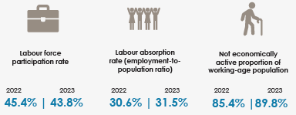

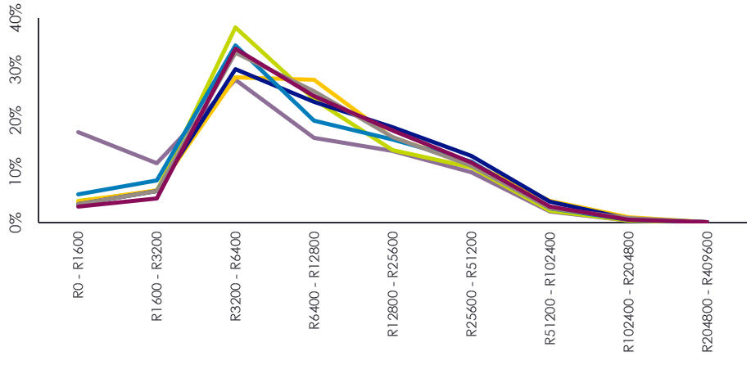


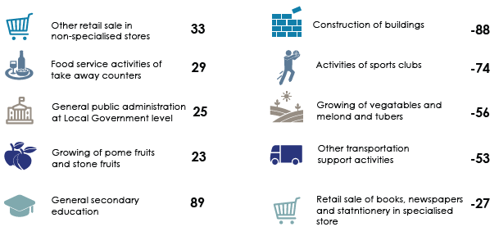

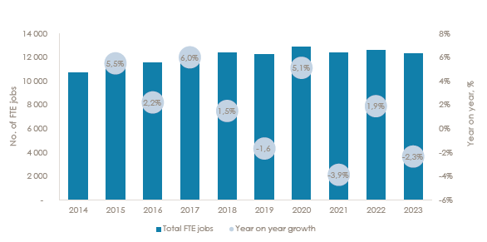
LABOUR MARKET PERFORMANCE
Wage Distribution per municipal area, 2023
2021e
Constant price growth
Unemployment rate (per cent) 2019-2023
Top 5 Sectors for job gains and job losses (FTE)
2022-2023
Top 5 Sectors
Sector | No. of FTE Jobs
Mixed farming | 1 171
General public administration at Local Government level | 977
Slaughtering, dressing and packing of livestock, including poultry and small game for meat | 880
Public order and safety activities at National Government level | 660
General public administration at Provincial Government level | 653

Slide 20
LABOUR MARKET PERFORMANCE
The Oudtshoorn labour market reflects both progress and challenges, shaped by declining participation rates and shifts in sectoral dynamics. The labour force participation rate decreased from 45.4 per cent in 2022 to 43.8 per cent in 2023, while the labour absorption rate saw a slight improvement from
30.6 per cent to 31.5 per cent. The proportion of the working-age population not economically active increased to 89.8 per cent, highlighting structural barriers to labour market integration.
The local workforce comprises primarily semi-skilled workers (30 per cent), followed by low-skilled
(26.5 per cent), skilled (24.6 per cent), and informal workers (19 per cent). Wage distribution trends reveal a concentration in the R3 200–R12 800 range, consistent across municipalities within the Garden Route District, suggesting a predominantly middle-income demographic with limited high-wage earners, with prominent work opportunities in lower income farming activities.
Unemployment in Oudtshoorn remained high at 32.4 per cent in 2023, and is significantly higher than the Garden Route District average of 24.6 per cent. Long-term trends indicate a recovery from the 2021 peak of 37.3 per cent, yet persistent disparities require targeted interventions to support job creation and economic inclusion.
Between 2022 and 2023, the highest job gains occurred in: General secondary education (+89 FTE jobs); other retail sale in non-specialized stores (+33 jobs) and food services activities (+29 jobs). Conversely, significant losses were recorded in: Construction of buildings (-88 jobs); activities of sports clubs (-74 jobs); growing of vegetables(-56 jobs). These trends suggest a need for policies supporting vulnerable industries while reinforcing resilient sectors.
Key employment sectors in Oudtshoorn include: Mixed farming (1 171 FTE jobs) Public administration (977 jobs); Slaughtering and meat packing (880 jobs) and Public order and safety (660 jobs). This reflects a balanced dependence on agricultural, administrative, and service-oriented industries, underscoring the importance of sectoral diversification for sustainable growth. Total FTE jobs declined by 2.3 per cent year-on-year in 2023, following a volatile decade marked by growth peaks in 2020 (+5.1 per cent) and contractions in 2021 (-3.9 per cent) highlighting the labour market’s sensitivity to external shocks and economic policy changes.
Overall, Oudtshoorn’s labour market reflects gradual recovery tempered by structural challenges. This reflects the need to expand training programs targeting low- and semi-skilled workers to improve employability and productivity; promote recovery in construction, sports activities, and agriculture through subsidies, investment incentives, and technical assistance; and inclusive policies address barriers to economic participation, particularly among youth and women, to increase labour force engagement. Strategic investments in education, skill development, and sector-specific growth initiatives will be pivotal in ensuring sustainable economic progress and social equity.

Slide 21

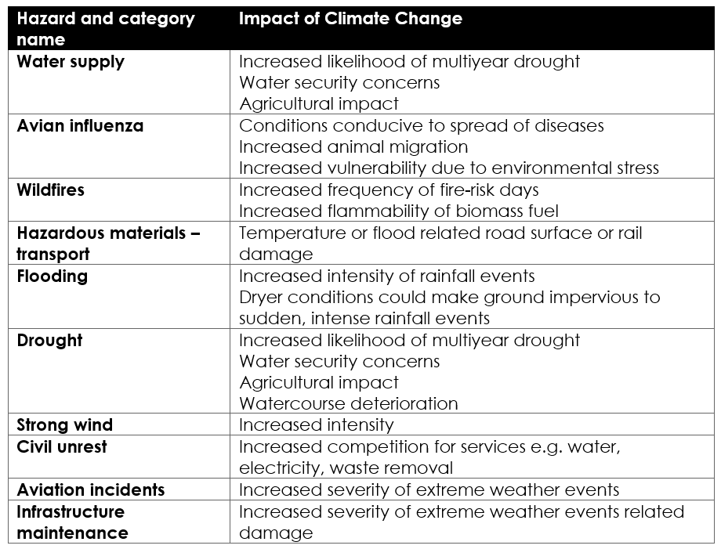
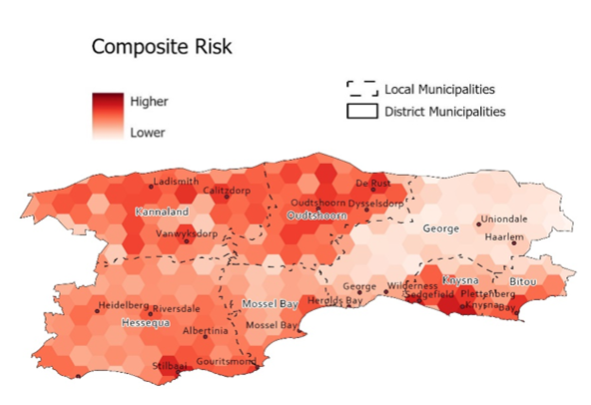
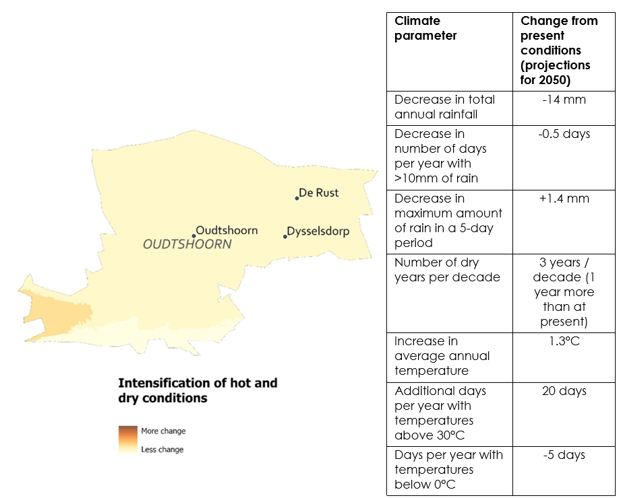
RISK AND VULNERABILITY FACTORS
HAZARDS*
ENVIRONMENTAL THREATS
CLIMATE RISKS
* Le Roux, A., van Niekerk, W., Arnold, K., Pieterse, A., Ludick, C., Forsyth, G., Le Maitre, D., Lötter, D., du Plessis, P. & Mans, G. 2019. Green Book Risk Profile Tool. Pretoria: CSIR. Available at: riskprofiles.greenbook.co.za
† Jack, C., Van Aardenne, L., Wolski, P., Pinto, I., Quagraine, K. & Kloppers, P. 2022. SmartAgri: Updated Climate Change Trends and Projections for the Western Cape. Cape Town: University of Cape Town. Available at https://www.elsenburg.com/wp-content/uploads/2022/08/SmartAgri-Climate-Change.pdf

Slide 22
RISK AND VULNERABILITY FACTORS
Environmental Threats
People face environmental threats, including degraded ecosystems, wildfires, floods, coastal erosion, poor air quality and waste disposal. These can be mapped in combination with socio-economic conditions and municipal response capacity to create a basic map of where environmental risks are the highest.
Climate Risks
The climate is slowly changing due to human-induced greenhouse gas emissions. The changes expected by mid-century are listed in the table.
Oudshoorn faces a number of environmental threats, including from deteriorating ecosystem functioning, water security concerns, floods and wildfires. At the same time, modelling of climate systems allows us to anticipate what the climate will look like later in the century, and hence where and how the environmental risks are likely to intensify.
Disaster Risks
Disaster Risk Management is important not only for everyday safety of people, but also to reduce the costs of disasters when they strike. The table in the infographic lists some ways in which climate change will impact disaster risks identified in the Disaster Management Plan (2024) of the municipality.
Climate change will result in decreases in rainfall in spring and especially autumn, although the overall annual change will be limited. Projections, however, indicate that by 2050, drought risk in the Garden Route District Municipality will increase from 2 possible drought years per decade to 3 years per decade, mainly driven by increased overall temperatures as higher rates of evaporation will increase the risk of water supplies running low. Insufficient water will interrupt agricultural production as well as agricultural and marine product processing, whilst placing severe constraints on towns and settlements.
Although drought is a major concern going forward, flooding remains as big a concern for Oudshoorn Municipality as the projections indicate increased storm intensity in winter, leading to more rainfall in shorter periods and therefore a higher likelihood of flooding. This points to high climate variability remaining a defining characteristic of the area.
Temperatures in Oudshoorn municipal area will continue to rise, resulting in 20 more hot days (temperatures above 30 degrees Celsius) per year by 2050. By 2050, the region will also decrease the number of frost days. On hot days productivity becomes constrained, and the risk of wildfires increase rapidly. In an already dry environment, wildfires can become extremely destructive.
Climate parameter | Change from present conditions (projections for 2050)
Decrease in total annual rainfall | -14 mm
Decrease in number of days per year with >10mm of rain | -0.5 days
Decrease in maximum amount of rain in a 5-day period | +1.4 mm
Number of dry years per decade | 3 years/decade (1 year more than at present)
Increase in average annual temperature | 1.3°C
Additional days per year with temperatures above 30°C | 20 days
Days per year with temperatures below 0°C | -5 days

Slide 23
CONCLUSION
Oudtshoorn, a municipal area situated in the semi-arid plains of the Klein Karoo, serves as a distinctive focal point for both the ostrich Industry and tourism. Despite the challenges posed by the COVID-19 pandemic, the municipal economy has successfully rebounded. While employment recovery initially lagged the economic resurgence, 2022 witnessed a significant net job growth, predominantly driven by an upswing in informal employment opportunities. This positive development has had a favorable impact on unemployment and poverty rates.
However, notwithstanding these improvements, the Municipality remains susceptible to elevated levels of poverty and unemployment compared to the District average. These conditions contribute to heightened rates of child malnutrition and low birth weight, indicative of a deficiency in food security within the municipal area. Additionally, poverty raises concerns regarding safety and security, evidenced by escalating crime rates, particularly in drug-related crime, sexual offenses, common assaults, and malicious damage to property. Ensuring safety and security is of paramount importance for both the municipality and the Western Cape Government.
Progress has been made in the realm of education, signaling optimistic prospects for meeting the increasing demand for skilled individuals in the expanding tertiary sector of the municipal economy. The growth in the proportion of individuals with higher education qualifications can be attributed to the presence of higher education institutions in the municipal area. With the decrease in teenage pregnancies, learner retention rates have also improved. Regrettably, the matric pass rate experienced a decline from 2022 to 2023, primarily attributed to underperformance in mathematics and mathematical literacy, necessitating targeted interventions.
A constrained economy, coupled with a scarcity of higher-income job opportunities and a high dependency ratio, has led to heightened demands for housing, municipal services, and essential government provisions such as education and healthcare. To effectively address the outlined developmental challenges and enhance the well-being of residents in the municipal area, sustained collaboration among the Municipality, other tiers of government, and the private sector is imperative.

Slide 24
SOURCES
1. Demographics
  Population: Department of Social Development, 2024; 2024 MYPE
  Sex ratio: Department of Social Development, 2024
  Age cohorts: Department of Social Development, 2024;
  Number of households: Department of Social Development, 2024;
  Household size: Department of Social Development, 2024;
  Racial Split: Department of Social Development, 2024
  Population density: Department of Social Development, 2024
2. Education
  Learner enrolment: Western Cape Education Department, 2024; Annual Survey of Public and Independent Schools (ASS), 2024
  Learner-teacher ratio: Western Cape Education Department, 2024; Annual Survey of Public and Independent Schools (ASS), 2024
  Learner retention: Western Cape Education Department, 2024; Annual Survey of Public and Independent Schools (ASS), 2024
  Educational facilities: Western Cape Education Department, 2024; Annual Survey of Public and Independent Schools (ASS), 2024
  No-fee schools: Western Cape Education Department, 2024; Annual Survey of Public and Independent Schools (ASS), 2024
  Schools with libraries: Western Cape Education Department, 2024; Annual Survey of Public and Independent Schools (ASS), 2024
  Educational outcomes: Western Cape Education Department, 2024; Annual Survey of Public and Independent Schools (ASS), 2024
3. Health
  Healthcare facilities: Department of Health and Wellness, 2024
  Emergency medical services: Department of Health and Wellness, 2024
  HIV/AIDS: Department of Health and Wellness, 2024
  Tuberculosis: Department of Health and Wellness, 2024
  Child health: Department of Health and Wellness, 2024
  Maternal health: Department of Health and Wellness, 2024
4. Poverty
  GDPR per capita: Own calculations from Quantec 2024 and MYPE 2024
  Income Inequality (Gini-coefficient): S&P Global Regional Explorer, 2024
  Human Development (Human Development Index): S&P Global Regional Explorer, 2024
2023 Socio-Economic Profile: Oudtshoorn Municipality
24

Slide 25
SOURCES
5. Basic services
  Households: Department of Social Development, 2024; MYPE 2021
  Access to housing: Quantec Research, 2024
  Access to water: Quantec Research, 2024
  Access to electricity: Quantec Research, 2024
  Access to sanitation: Quantec Research, 2024
  Access to refuse removal: Quantec Research, 2024
  Free Basic Services: Department of Local Government, 2024
6. Safety and security
  Murder: South African Police Service (SAPS), 2024, own calculations
  Sexual offences: South African Police Service (SAPS), 2024, own calculations
  Drug-related crimes: South African Police Service (SAPS), 2024, own calculations
  Driving under the influence: South African Police Service (SAPS), 2024, own calculations
  Residential burglaries: South African Police Service (SAPS), 2024 own calculations
7. GDPR Performance
  GDPR Sector Performance: Quantec Research, 2024
  GDPR Forecasts: Quantec Research, 2024
  International Trade: Quantec Research, 2024
  Tourism spend: S&P Global Regional Explorer, 2024
  8. Labour Market Performance
  Wage distribution: Nell, A. Visagie, J. Spatial Tax Panel 2014-2023 [dataset]. Version 3. National Treasury - Cities Support Programme and Human Sciences Research Council [producer and distributor], 2024.
  Formal Employment: Nell, A. Visagie, J. Spatial Tax Panel 2014-2023 [dataset]. Version 3. National Treasury - Cities Support Programme and Human Sciences Research Council [producer and distributor], 2024.
  Trends in labour force skills: Quantec Research, 2024
  Unemployment rates: Quantec Research, 2024

